Slide 1
Workload Optimized Silicon
2016 June 30

Slide 2
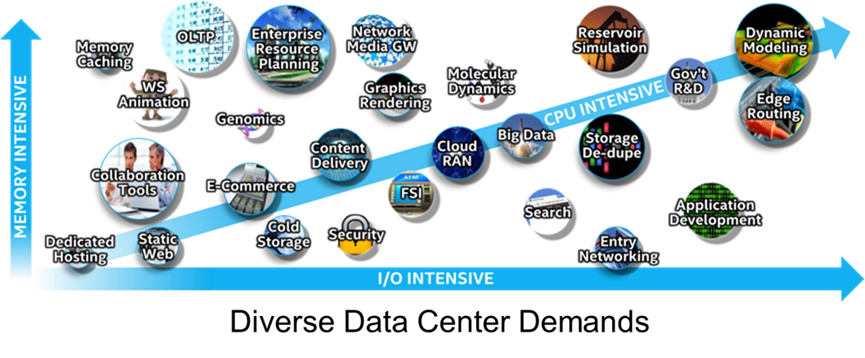
Workload Optimized Silicon
Cost effectively optimizing a server’s processor to the workload it performs
Notes:
Organizations are using a diverse set of workloads. Optimizing each workload is a challenge for the data center. To meet this challenge, Intel has developed a number of different processor lines that meet the compute needs for these diverse server workloads and maximize performance and ROI.
Workloads requirements matched to the optimal mix of CPU, memory, I/O, and advanced technology built into the latest Intel processor provide peak performance. Traditionally, customers have standardized on servers configured to meet general-purpose workloads – sacrificing workload optimization for data center standardization.
This standardized approach essentially allows diverse workloads to run on any server and attempts to maximize ROI by reducing the number of server configurations maintained in the data center. Adopting a workload-optimized technique when configuring servers in the data center can lower overall datacenter costs while providing several major advantages:
Provides servers with the best CPU, memory and I/O performance for the workload improving performance and throughput for critical application
Takes advantage of the advanced Intel technology built into the processor, further optimizing server performance for specific workloads
Orchestrates with the most advanced Data Center Infrastructure Management (DCIM),the marriage of information technology and data center facility management disciplines, to optimize overall datacenter costs and performance

Slide 3

Workload Optimized Server Selection Approach
Maximizes Return on Investment
Maximizes Workload Performance
Four Areas of Focus
  Business Case - including TCA and TCO
  Workload Characteristics – Technical Profile of Workload
  Scale – Planned Growth and Peak Workloads
  Application Considerations – Optimize Software Pricing Models
Notes:
Of course, optimizing the processor is not the only consideration for customers in data center purchase decisions. Customers challenged to provide the best possible workload performance in the most cost effective manner measure new data center upgrades based upon return on investment (ROI).
Maximizing ROI using a workload-optimized approach focuses on four main areas:
Business case – Acquisition costs of the hardware, software and services required, along with total cost of ownership (TCO) weigh against the business value of the server. Maximizing the workloads performed on a server increases its business value and lowers TCO.
Workload characteristics – what is the technical profile of the workload? Does it scale with cores, is latency or throughput most important, require large memory or fast I/O to maximize performance? Configuring the server to maximize workload performance allows more work to be done on each server, lowering overall costs.
Scale – How does the acquisition handle peak workloads and future growth? Planning growth within the server prevents the need for additional servers, lowering overall costs.
Application considerations – Workload optimized silicon can also take advantage of the pricing models for application software. Minimizing the cores in a server can reduce the overall cost for applications priced per core. Maximizing processor frequency can optimize costs for applications priced per processor.

Slide 4




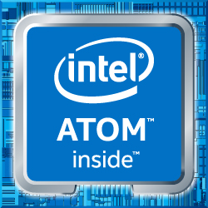


Acquisition Cost
Number of Workloads
Latency vs. Throughput
TCO
Workload
Characteristics
Scalar vs. Vector
Business
Case
Type of Workloads
Memory Bandwidth
HW
SW
Workload Criticality
Memory Capacity
People
Core Scaling
Infrastructure
Reliability/Security
Scale
Application
Line of Business Leader
IT Leader
Virtualization
Custom Code
ISV
Future Capacity & Failover
Decisions
Software
Clouds/Pools
Scalability
Workload Optimized Processor
Networking
Storage
Homogenous
Single Node
Intel® Xeon® Processor E5
Intel® Xeon® Processor E7
Intel® Xeon® Processor E3
Intel® Xeon ® Phi™ Processor
Intel® Xeon® Processor D
Intel® Atom™ Processor
Scale Up
Intel® Omni-Path Fabric
Intel® Solid State Drives
Optimized
Scale Out
Chart from Intel
Notes:
Of course, optimizing the processor is not the only consideration for customers in data center purchase decisions. Customers challenged to provide the best possible workload performance in the most cost effective manner measure new data center upgrades based upon return on investment (ROI).
Maximizing ROI using a workload-optimized approach focuses on four main areas:
Business case – Acquisition costs of the hardware, software and services required, along with total cost of ownership (TCO) weigh against the business value of the server. Maximizing the workloads performed on a server increases its business value and lowers TCO.
Workload characteristics – what is the technical profile of the workload? Does it scale with cores, is latency or throughput most important, require large memory or fast I/O to maximize performance? Configuring the server to maximize workload performance allows more work to be done on each server, lowering overall costs.
Scale – How does the acquisition handle peak workloads and future growth? Planning growth within the server prevents the need for additional servers, lowering overall costs.
Application considerations – Workload optimized silicon can also take advantage of the pricing models for application software. Minimizing the cores in a server can reduce the overall cost for applications priced per core. Maximizing processor frequency can optimize costs for applications priced per processor.

Slide 5

Processor Selection Considerations
Number of cores
Speed (frequency) of the processor
Power the processor uses (in Watts)
Amount of last level cache (LLC Cache)
Speed of the Intel QuickPath Interconnect (QPI)
Speed of DDR4 memory
Advanced Processor Features

Slide 6
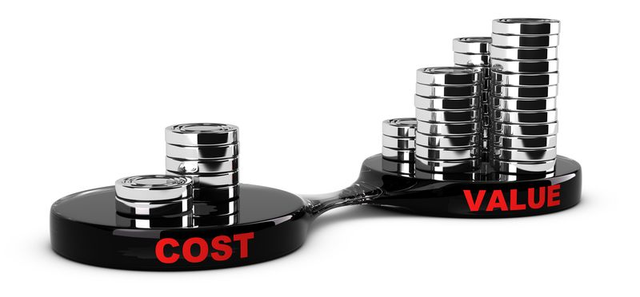
Application Benefits of Workload Optimized Silicon
Matching Processor to the Application/Workload
  Optimizes application/workload performance
  Can reduce the total servers needed
  Takes advantage of processor features
  Provides application/workload scale
  Optimizes TCO
Notes:
Matching the processor to the application or workload will optimize performance of the server in the datacenter. While each environment is unique, this chart can be used as a general guideline when selecting a processor

Slide 7
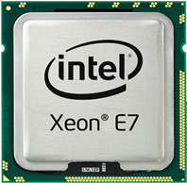
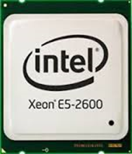
Workload Optimized Processor Choices
Intel E5 and E7 Processor Families provide the choices to optimize workloads
Intel Processor E7 Family
  Up to 24 cores
  Memory Frequency of 2400 MHz
  Last Level Cache up to 60MB/core
  Intel QPI Bus Speed 3 times 9.6GT/s
Intel Processor E5 Family
  Up to 22 cores
  Memory Frequency from 1866 MHz – 2400 MHz
  Last Level Cache from 2.5MB/core to 3.75MB/core
  Intel QPI Bus Speed from 6.4 GT/s to 9.6 GT/s
Notes:
The E5 v4 product family is broken down into six further segments. Each segment of processors contains useful characteristics that, when compared to the optimal characteristics of an application or workload, help select the optimal processor for the server. These segments are Basic, Standard, Low Power, Advanced, Frequency Optimized, and Segment Optimized.
Each of these processor and processor segments differ based upon the characteristics of the processors including:
Number of cores
Speed (frequency) of the processor
Power the processor uses (in Watts)
Amount of last level cache (LLC Cache)
Speed of the Intel QuickPath® Interconnect (QPI) which is the ‘bus’ speed or the internal speed of the servers
Speed of DDR4 memory

Slide 8
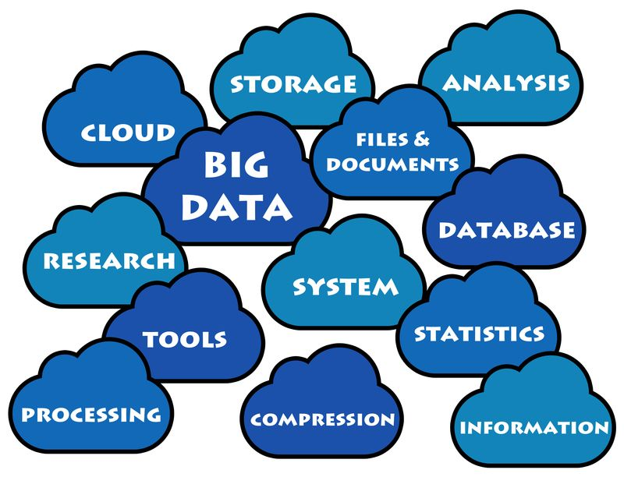
Optimizing Workloads to Intel Processor
Intel Guidelines Match Processor to Workload
E7 Processor Family
  Ideal for Scale-Up Workloads
  Provides High Memory and I/O Bandwidth
E5 Processor Family Features
  Ideal for Scale-Out Workloads
  Caters to a Wide Range of Applications
    Provides High Core Count Options
    Provides High Frequency Options

Slide 9

Workloads for E7 Processor Family
Notes:
General guidelines are useful to match the general capabilities of a processor to a workload category.
Intel has provided more specific guidelines based upon specific workload applications where Intel processors are deployed.
In these charts, the dark green indicates where a processor is very applicable for a workload. The lighter green indicates where a processor is applicable for the workload. If a processor is not listed for a particular workload, it is not optimal for that workload

Slide 10
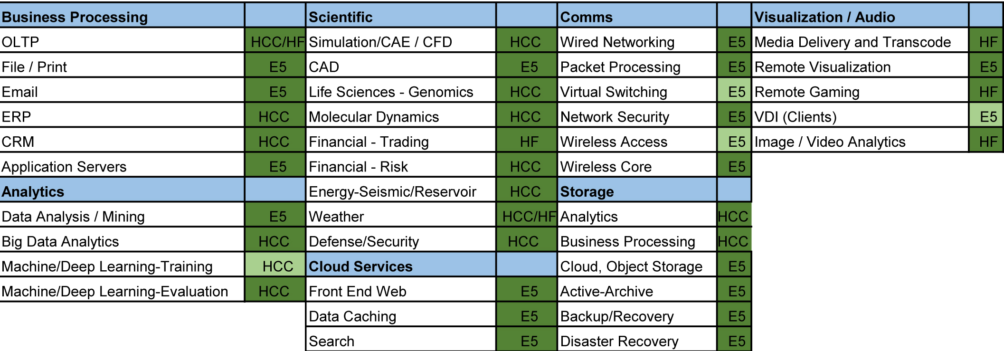
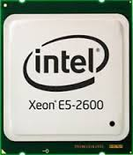
Workloads for Intel Processor E5 Family
Notes:
General guidelines are useful to match the general capabilities of a processor to a workload category.
Intel has provided more specific guidelines based upon specific workload applications where Intel processors are deployed.
In these charts, the dark green indicates where a processor is very applicable for a workload. The lighter green indicates where a processor is applicable for the workload. If a processor is not listed for a particular workload, it is not optimal for that workload.
E5 indicates any E5 family member processor, HCC indicates a E5 High Core Count processor is preferred, and HF indicates a E5 High Frequency processor is preferred for those workloads.

Slide 11
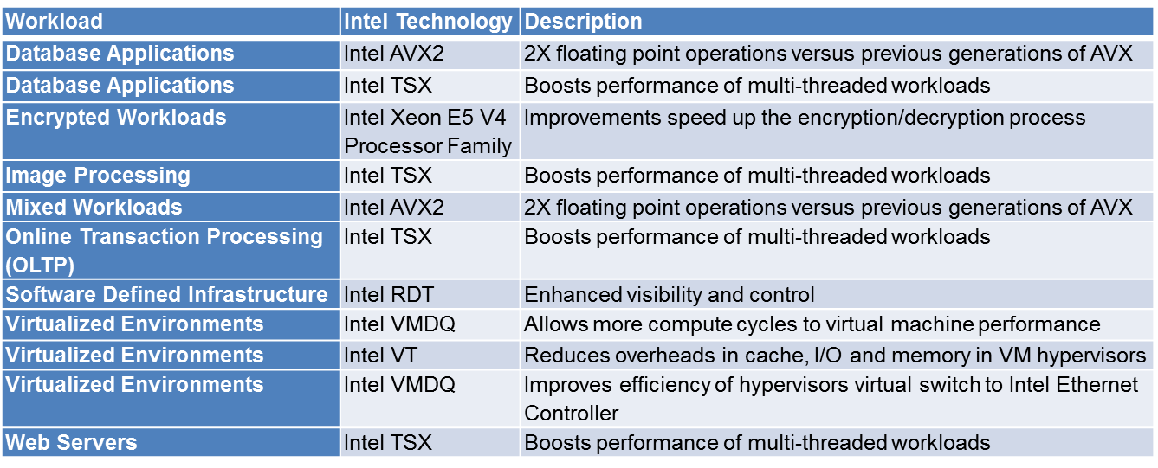
Optimizing Intel Xeon Processor E7 and E5 Workloads
Intel Advanced Features to Accelerate Workloads
Notes:
The Intel Xeon Processor E7 v4 and E5 v4 family of processors provide a powerful array of performance features that, when matched with applications and workloads designed to take advantage of these features, significantly increase application performance and efficiency. These features are noteworthy because when servers are tuned to take full advantage of them, they can further increase performance for a workload.
Standard processor features for both families include:
Advanced Features that optimize select workloads. These include Intel AVX2, Intel TSX, Intel RDT, Intel VMDQ and Intel VT technology. More information on these technologies is contained in the resource section.
Intel Hyper-Threading Technology, which enables multiple threads to run on each core more efficiently and increases overall performance on threaded software, (available with most, but not all processors in this family).
Intel Turbo Boost Technology, which enables the processor to run above its base operating frequency, allowing the processor to speed up to meet peak demands, (Available in all but the basic category in the E5 family).
The chart lists a sampling of workloads that can benefit from workload-optimized silicon. Also listed are the Intel technology that enables it and a brief description of the technology. A more detailed description of the technology is in resources section.

Slide 12
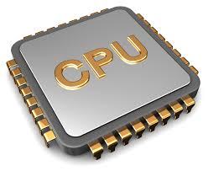
Workload Optimized Silicon Summary
Helping your customers move to a workload-optimize server configurations provides:
  Servers configured to workload, not general purpose computing
  Takes advantage of performance features and characteristics of Intel processors
  Maximizes total cost of ownership
  Maximizes return on investment
Notes:
Customers select the best datacenter solution based on many factors, including the business case, the workload characteristics, the scale of the problem, which application software is being used, and planning for future growth to maximize the return on their data center investment. You need to help your customers add one more important factor in their datacenter decisions – move away from servers configured for general computing and adopting a workload-optimized model that leverages the performance features and characteristics of specific Intel Server processors to maximize their TCO and ROI.

Slide 13
Resources
Intel Xeon Processor E7 v4 Product Family
Intel Xeon Processor E5-2600 v4 Product Family
Intel Xeon Processor E5-2600 v4 Product Family – Overview Animation
Intel Xeon Processor E5-2600 v4 Product Family – Product Brief
Intel VMDq Explanation (Video)
Intel SR-IOV Explanation (Video)
Web Resources about Intel TSX
Intel RDT Web Page
List of Intel Virtualization Technology (Intel VT) Supported Products

